Slide 1
Storage (LBS)
V1
.Net
V1
.Net
ConfigMap
Storage (Disk)
Secret
Storage (NFS)
V2
.Net

Slide 2
Onpremise
.Net
.Net
.Net
ns=Qas
Client
Monitoring
Dev
ns=Dev
Qas
Prd
ns=Prd
.Net
.Net
.Net
Load Balancer
Client
.Net
Java
.Net
Java
.Net
.Net
V2
Client
StateLess - ServerLess
Functions
Azure Function
Lambda Function
Python
NodeJs
Python
NodeJs
.Net
V2
.Net
V2
Client
Secret
ConfigMap
.Net
V2
.Net
Java
Cloud
Python
NodeJs
Monitoring
Dev
Qas
Prd
.Net
Java
.Net
Java
.Net
Java
AKS = Azure Kubernetes Service
EKS = Elastic Kubernetes Service
GKS = Google Kubernetes Service
Openshift => Cloud/On-Premise
Fork Kubernetes
Python
NodeJs
Python
NodeJs
Python
NodeJs
AKS = Azure Kubernetes Service
EKS = Elastic Kubernetes Service
GKS = Google Kubernetes Service
Openshift => Cloud/On-Premise
Fork Kubernetes

Slide 3
Onpremise (130 GB RAM, 40 CPU’s, 17TB)
.Net
.Net
.Net
Client
Monitoring
Dev
Qas
Prd
.Net
.Net
.Net
Load Balancer
Client
.Net
Java
.Net
Java
.Net
.Net
V2
Client
StateLess - ServerLess
Functions
Azure Function
Lambda Function
Python
NodeJs
Python
NodeJs
.Net
V2
.Net
V2
Client
Secret
ConfigMap
.Net
V2
.Net
Java
Python
NodeJs
Master’s (3 node)
Worker’s (node)
10TB
30 GB RAM
10 CPU’s
Linux (Ubuntu,Debian, CentOS)
RedHat OS
30 GB RAM
10 CPU’s
Linux (Ubuntu,Debian, CentOS)
60 GB RAM
15 CPU’s
Linux (Ubuntu,Debian, CentOS)
10 GB RAM
5 CPU’s
Linux (Ubuntu,Debian, CentOS)
30 GB RAM
10 CPU’s
Linux (Ubuntu,Debian, CentOS)
30 GB RAM
10 CPU’s
Linux (Ubuntu,Debian, CentOS)
.Net
V2
.Net
V2
.Net
V2
.Net
V2
AKS = Azure Kubernetes Service
EKS = Elastic Kubernetes Service
GKS = Google Kubernetes Service
Openshift => Cloud/On-Premise
Fork Kubernetes
5TB
2TB

Slide 4
Onpremise (130 GB RAM, 40 CPU’s, 17TB)
.Net
.Net
.Net
Prd
Load Balancer
DNS
Client
Monitoring
Pod : IP xxx.xxx.xxx.xxx
Deployment
.Net
.Net
.Net
.Net
V2
ReplicaSet = 2, .Net V2
Client
Liveness Probe
Port: 80
Port: 80
.Net
.Net
V2
Service
Client
StateLess - ServerLess
Functions
Azure Function
Lambda Function
Pod : IP yyy.xxx.xxx.xxx
Container
ISTIO
Agent
Readiness Probe
.Net
V2
.Net
V2
.Net
V2
Client
Port: 80
Port: 80
Usar imagen Docker app.net01
2 instancias
Almacenamiento 3GB
1 CPU
2GB RAM
YAML
.Net
V2
.Net
Java
Python
NodeJs
Master’s (3 node)
Worker’s (node)
10TB
30 GB RAM
10 CPU’s
Linux (Ubuntu,Debian, CentOS)
RedHat OS
30 GB RAM
10 CPU’s
Linux (Ubuntu,Debian, CentOS)
60 GB RAM
15 CPU’s
Linux (Ubuntu,Debian, CentOS)
10 GB RAM
5 CPU’s
Linux (Ubuntu,Debian, CentOS)
30 GB RAM
10 CPU’s
Linux (Ubuntu,Debian, CentOS)
30 GB RAM
10 CPU’s
Linux (Ubuntu,Debian, CentOS)
.Net
V2
.Net
V2
.Net
V2
.Net
V2
AKS = Azure Kubernetes Service
EKS = Elastic Kubernetes Service
GKS = Google Kubernetes Service
Openshift => Cloud/On-Premise
Fork Kubernetes
5TB
2TB

Slide 5
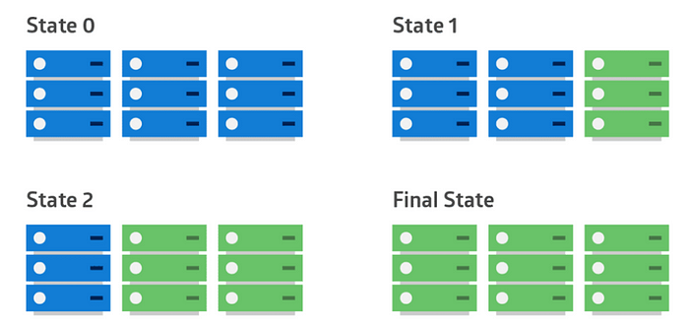
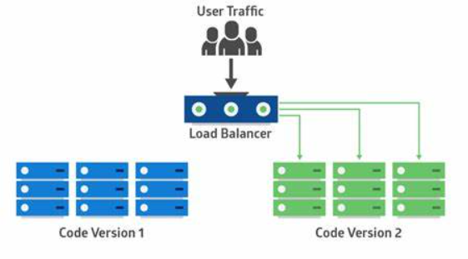
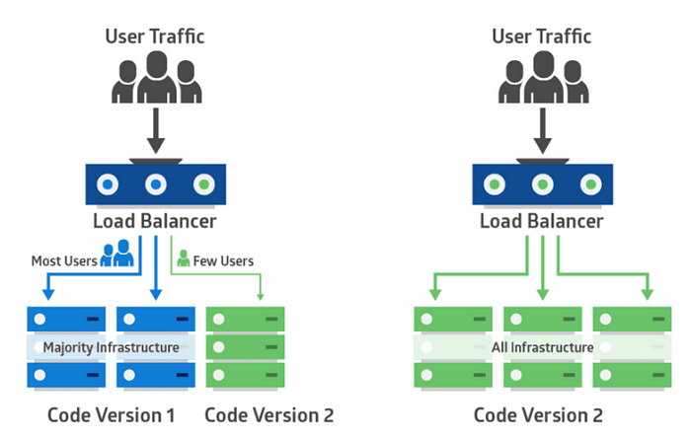
Rolling updates
Blue-Green
Canary

